Slide 1
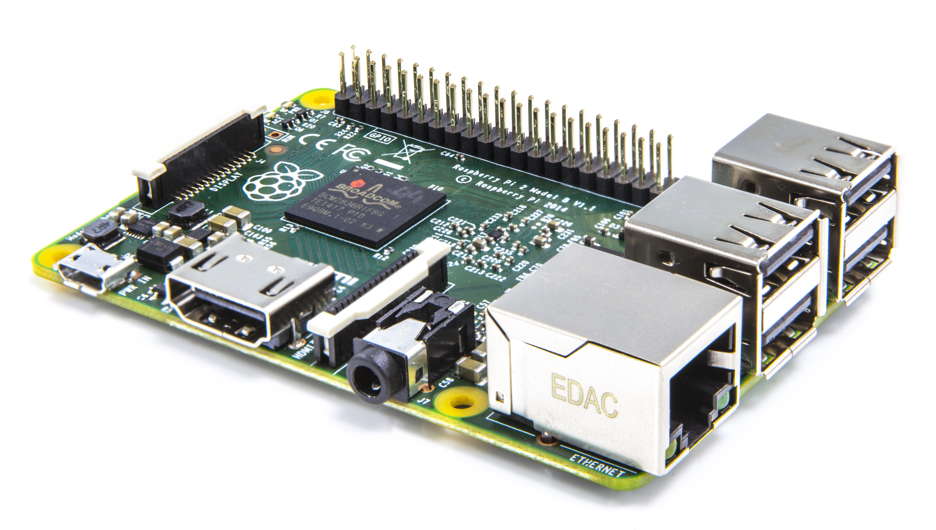
Raspberry Pisentation

Slide 3
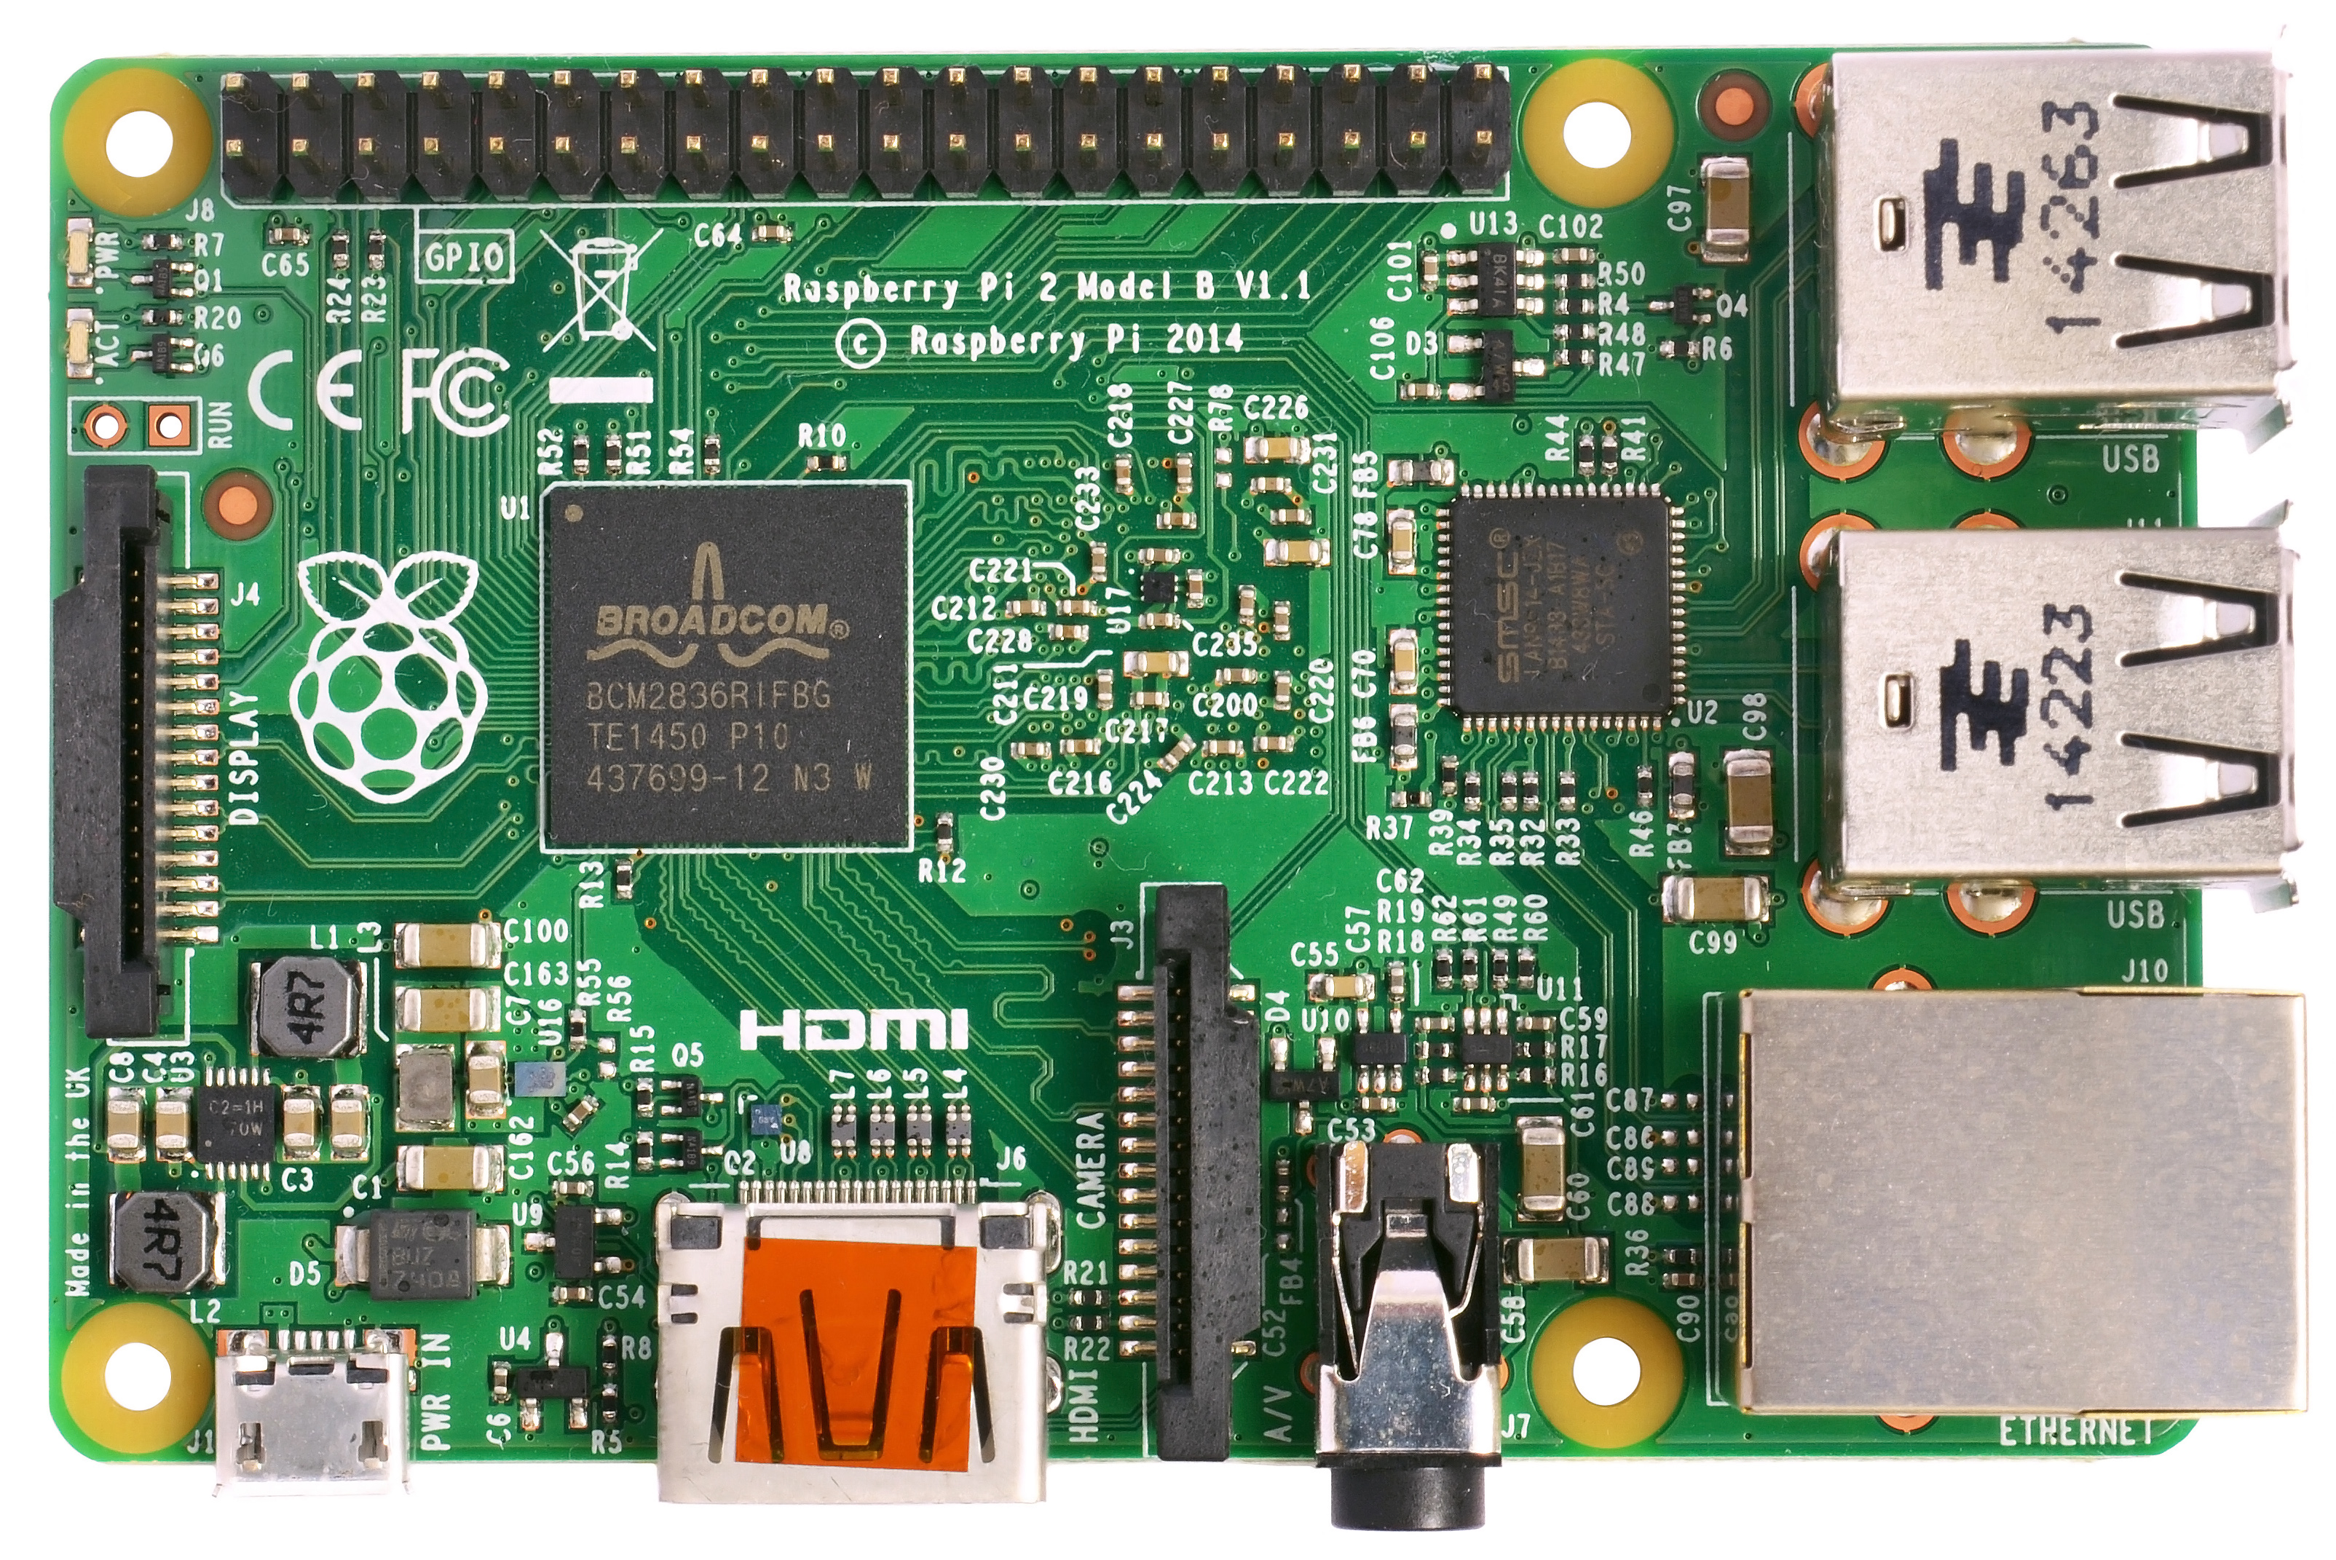

Slide 4
GPIO pins (40)
Central Processing
Cluser
Anti-trash receptical
Printed warning
Raspberry Pi 2
Model Number
Central (Micro)
Processing unit/chip
Screw Hole 2
Screw Hole 3
Mandatory
Conformity
Marking (Europe manufactured)
Universal
Serial Bus 3
USB 1
Display ribbon
analog output
Primary Universal
Serial Bus cluster
Federal
Communications
Commission
Declaration
of Conformity
Universal
Serial Bus 4
Rassberry
Pi logo
USB 2
USB control chip
(5 port)
Ethernet
Jack
Secondary
Universal Serial
Bus cluster
Screw Hole 1
Central
Power Cluster
Micro SD
card slot
HDMI Cert label
Screw Hole 4
Camera Ribbon
Input
Power
Video
4 Pole
Notes:
1.Micro SD card slot
2.Power
3.Video
4.4 pole
5.Ethernet
6.usb1
7.usb2
8.GPIO PINS (40)
9.Display ribbon anolog output
10.camera ribbon input
11.Central (micro) proccessing unit/chip
12.Screw hole 1
13. Screw hole 2
14. Screw Hole 3
15.Screw hole 4.
16. Primary USB cluster
17. Anti trash receptical printed warning
18. FCC declaration of Conformity
19. MCME
20.Central proccessing cluser
21. USB 2
22. Pi B+
23. USB control cluser
24. Serial bus control chip (5 port)
25. USB 3
26. Central power cluster
27. Pi logo
28. HDMI Standard
:D

Slide 5
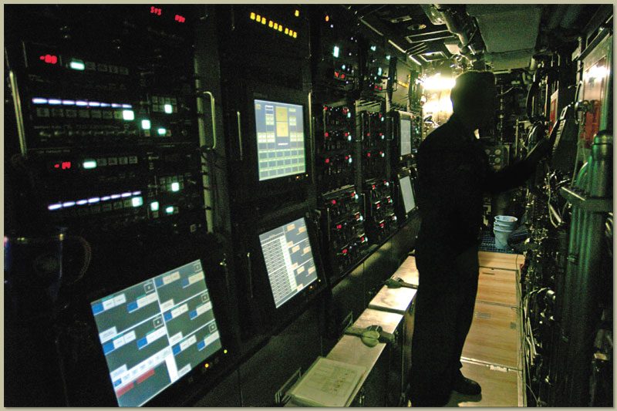
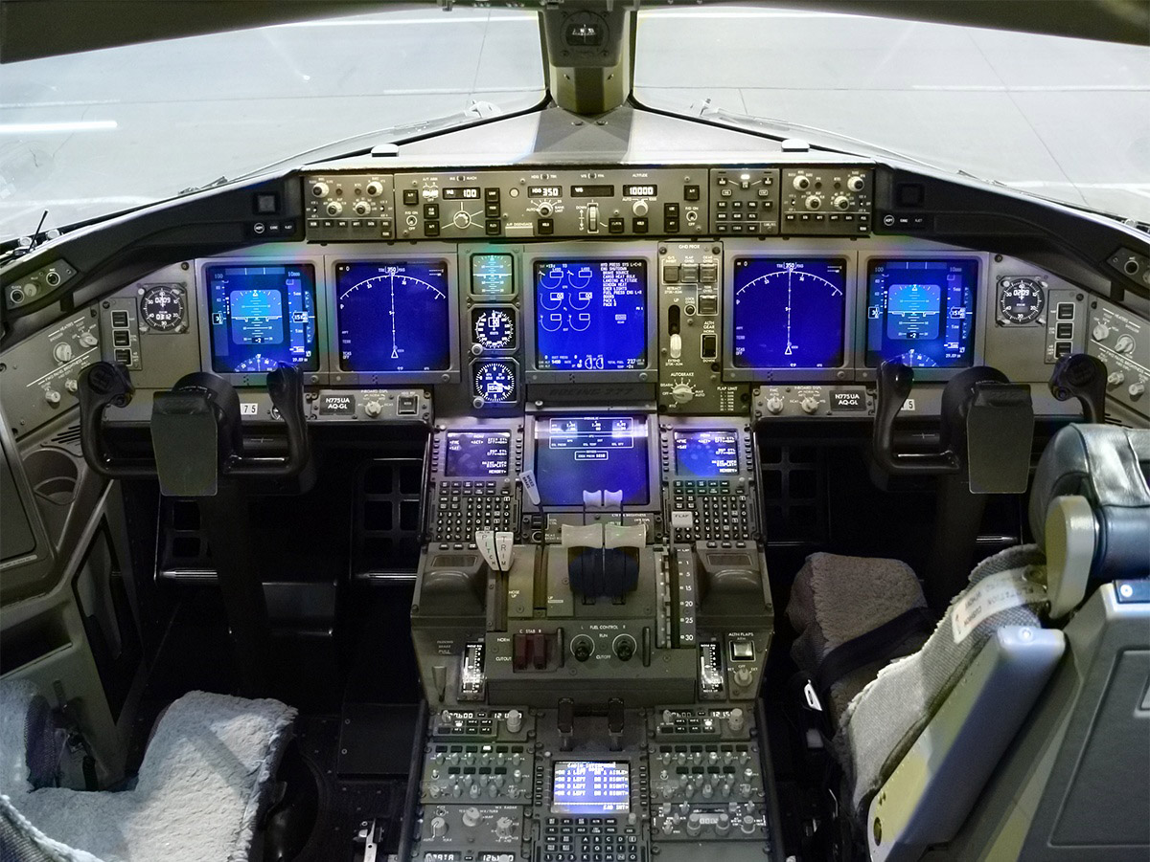
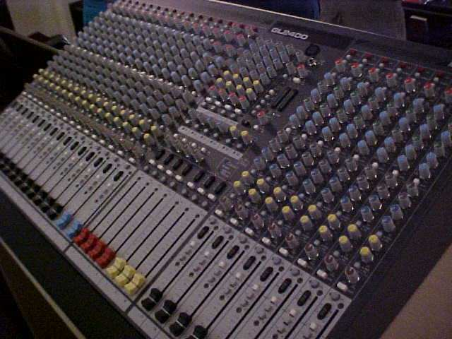
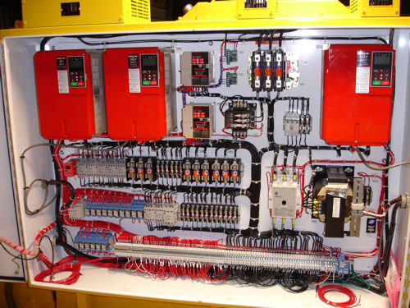
GPIO pins (40)
Central Processing
Cluser
Anti-trash receptical
Printed warning
Raspberry Pi 2
Model Number
Central (Micro)
Processing unit/chip
Screw Hole 2
Screw Hole 3
Mandatory
Conformity
Marking (Europe manufactured)
Universal
Serial Bus 3
USB 1
Display ribbon
analog output
Primary Universal
Serial Bus cluster
Federal
Communications
Commission
Declaration
of Conformity
Universal
Serial Bus 4
Rassberry
Pi logo
USB 2
USB control chip
(5 port)
Ethernet
Jack
Secondary
Universal Serial
Bus cluster
Screw Hole 1
Central
Power Cluster
Micro SD
card slot
HDMI Cert label
Screw Hole 4
Camera Ribbon
Input
Power
Video
4 Pole

Slide 6
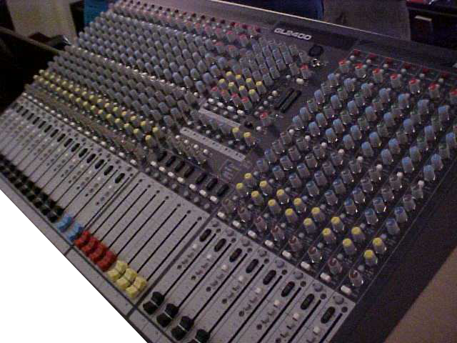
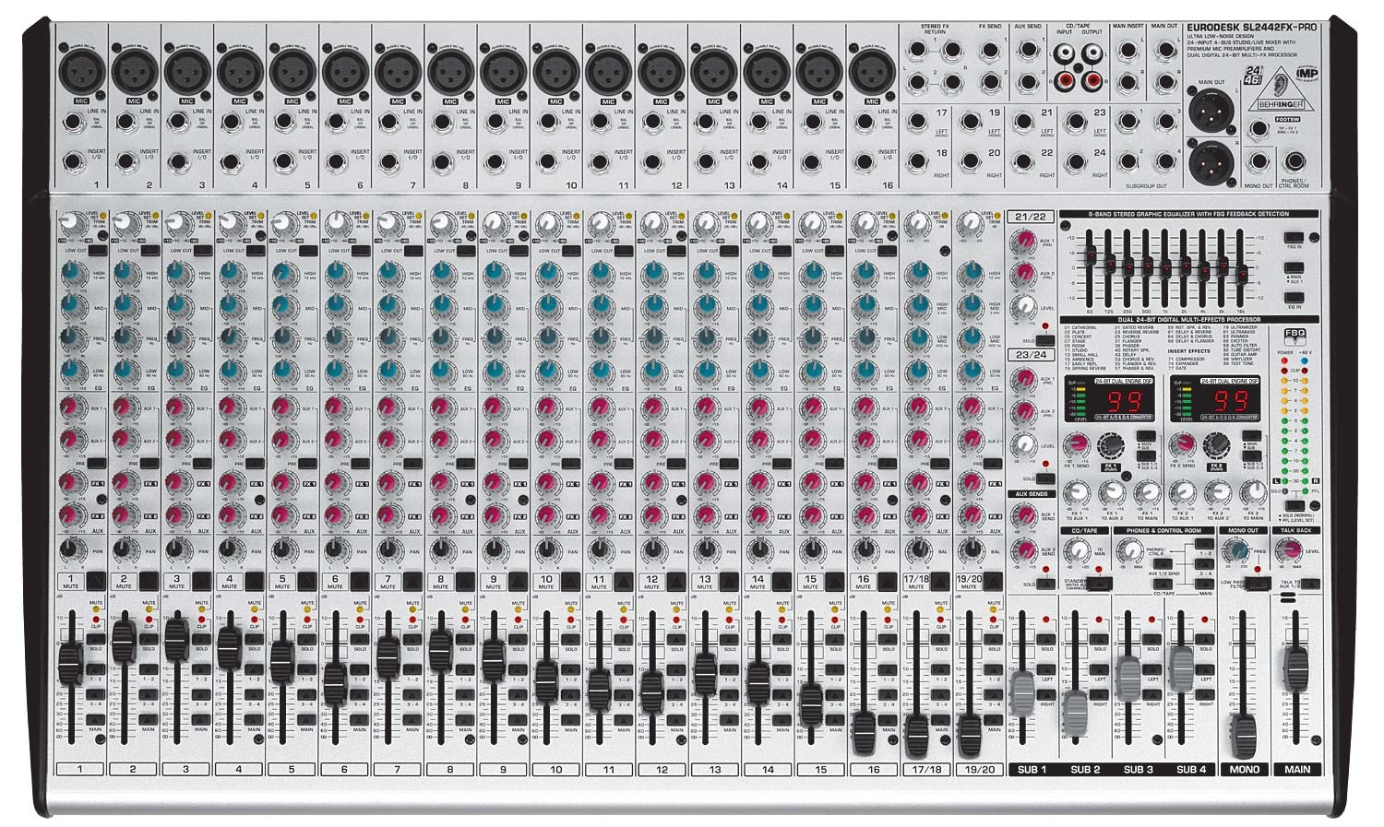
26 channels
450+ knobs
A bajillion buttons

Slide 9
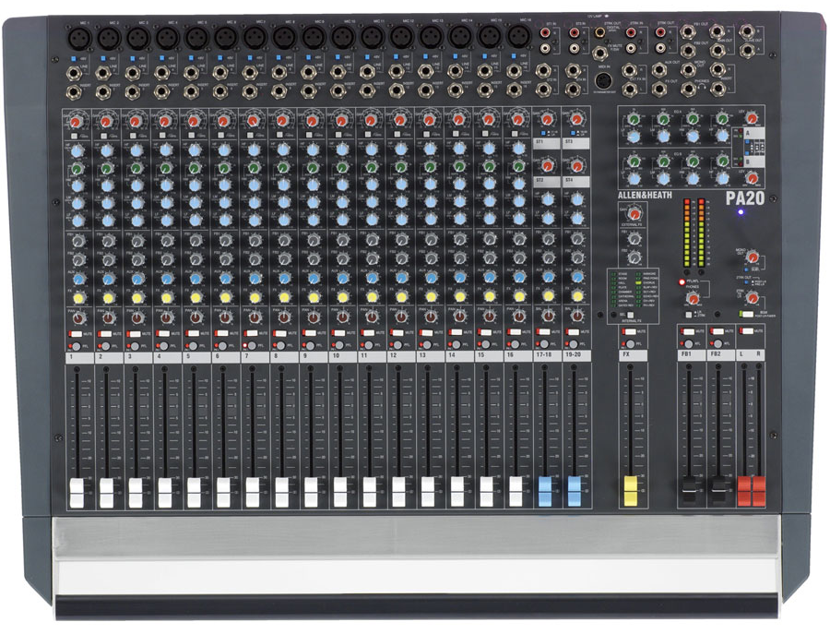
GPIO pins (40)
Central Processing
Cluser
Anti-trash receptical
Printed warning
Raspberry Pi 2
Model Number
Central (Micro)
Processing unit/chip
Screw Hole 2
Screw Hole 3
Mandatory
Conformity
Marking (Europe manufactured)
Universal
Serial Bus 3
USB 1
Display ribbon
analog output
Primary Universal
Serial Bus cluster
Federal
Communications
Commission
Declaration
of Conformity
Universal
Serial Bus 4
Rassberry
Pi logo
USB 2
USB control chip
(5 port)
Ethernet
Jack
Secondary
Universal Serial
Bus cluster
Screw Hole 1
Central
Power Cluster
Micro SD
card slot
HDMI Cert label
Screw Hole 4
Camera Ribbon
Input
Power
Video
4 Pole

Slide 10
GPIO pins (40)
Central Processing
Cluser
Anti-trash receptical
Printed warning
Raspberry Pi 2
Model Number
Central (Micro)
Processing unit/chip
Screw Hole 2
Screw Hole 3
Mandatory
Conformity
Marking (Europe manufactured)
Universal
Serial Bus 3
USB 1
Display ribbon
analog output
Primary Universal
Serial Bus cluster
Federal
Communications
Commission
Declaration
of Conformity
Universal
Serial Bus 4
Rassberry
Pi logo
USB 2
USB control chip
(5 port)
Ethernet
Jack
Secondary
Universal Serial
Bus cluster
Screw Hole 1
Central
Power Cluster
Micro SD
card slot
HDMI Cert label
Screw Hole 4
Camera Ribbon
Input
Power
Video
4 Pole
Notes:
1.Micro SD card slot
2.Power
3.Video
4.4 pole
5.Ethernet
6.usb1
7.usb2
8.GPIO PINS (40)
9.Display ribbon anolog output
10.camera ribbon input
11.central ()micro) proccessing unit/chip

Slide 12
GPIO
USB
Display
Camera
USB
Internet
Memory
Power
HDMI
A/V

Slide 13
GPIO
GPIO
USB
Display
Camera
USB
Internet
Memory
Power
HDMI
A/V

Slide 17
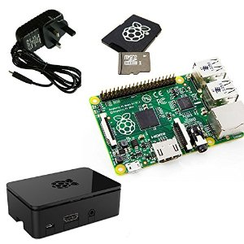
>Power Cable
>SD card
>Video cable
>Keyboard
>Wireless Adapter
>Speakers
>Pi Display
>Pi Camera
>Pi Case

Slide 18
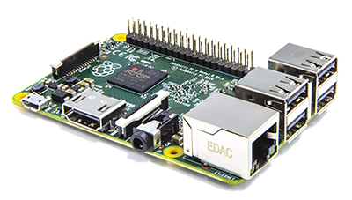
Raspberry Pisentation

Slide 19
Raspberry Pisentation

