Slide 1
Web Design: HTML & CSS
Written by:
Lauren Lewis
Mauricio Gomez
Presented by:
________________

Slide 2
What is Web Design?
“The planning and creation of websites”
Including:
Information architecture
User interface
Site structure
Navigation
Layout
Colors
Fonts
Imagery
All of these are combined with the principles of design to create a website that meets the goals of the owner and designer.

Slide 3
HTML vs. CSS
HTML
HTML is a markup language for describing web pages
“Hyper Text Markup Language”
A markup language is a set of markup tags
HTML documents are described by HTML tags
Each HTML tag describes different document content
CSS is a style sheet language used for describing the look
“Cascading Style Sheets”
It defines how HTML elements are to be displayed
Useful because it saves a lot of work
External Style Sheets are stored in CSS files
CSS

Slide 4
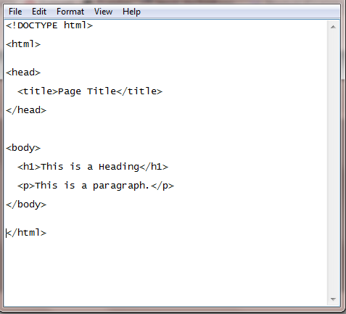
Basic HTML Shell
Notes:
HTML tags are keywords (tag names) surrounded by angle brackets:
<tagname>content</tagname>
HTML tags normally come in pairs like <p> and </p>
The first tag in a pair is the start tag, the second tag is the end tag
The end tag is written like the start tag, but with a slash before the tag name
HTML Attributes
HTML elements can have attributes
Attributes provide additional information about an element
Attributes are always specified in the start tag
Attributes come in name/value pairs like: name="value"

Slide 5
**Show CSS Sandbox
**Show website page source code to explain to students how complex this coding can get
**Talk about website we made and all the different tags and their meaning
**Allow students to create simple web page, maybe provide shell and allow them to change the design
**Return to PowerPoint deck

Slide 6
Real World Applications
Web designers and developers are needed in a variety of industries and businesses across the globe.
Websites allow organizations, companies, and government entities to:
Interact with customers
Provide information to the public
Market products and services
Execute operations

Slide 7
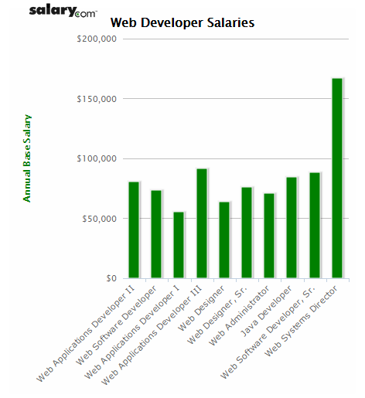
Careers & Salaries
About ¼ of web developers were self employed in 2012
The minimal education needed to become a web developer is an associate’s degree in web design or related field
Web developers need knowledge of both programming and graphic design
The median annual wage for web developers was $62,500 in May 2012
Employment of web developers is projected to grow 20% form 2012-2022, faster than the average for all occupations

Slide 8
Resources
www.w3schools.com
www.developer.mozilla.org
En-US/Learn/HTML.com
http://webdesign.tutsplus.com
Free
HTML/CSS Tutorials
www.wix.com
www.imcreator.com
www.weebly.com
www.wordpress.com
Free website creators

Slide 9
Follow us on Social Media!
/FITCAlliance
@FITCAlliance
@FITC_Alliance
#FITC
& visit fitc.cci.fsu.edu
FITC Group

