Slide 1
Presentation Skills
Written by:
Joey Cardenas Nicolaus Lopez
Hallie Lavery
Presented by:
____________________
Notes:
Pictures of famous presenters.

Slide 2
Outline
The importance of presentation skills?
Traits of a Bad/Great Presenter.
How to get great with presentations
Success in presentation skills
Productive
Present
Passion
Practice
Notes:
POINT to get across: Presentation skills is something everyone needs(like a cell phone) the ones who don’t have one aren’t necessarily failing in the world just the ones who do have the ability

Slide 3
Why are presentation skills important?
School
Club\Organization
Debating
Finding a Job
Notes:
Sort of section to talk to kids about why think presentation skills would be important. POINT TO GET ACROSS: Presentation skills is a very strong skill as its multifaceted, confidence in talking in front of crowds will make you a better individual in many other facets of life.

Slide 4
Identify traits of presenters
Traits of a BAD presenter:
Lots of text
Not knowing the topic
Bad design
Reading word for word
Traits of a GOOD presenter:
Make it relatable
Be relaxed
Keep it simple
Practice
Notes:
Talk to the kids about what are some bad traits they see in presenter when they
Why is it important to talk about what people do wrong/right in a presentation? POINT TO GET ACROSS: Identifying what others and getting feedback from others on your presentation will only help you grow. So have a sorta behind the scence critique in your head during this presentatino and look at what we did well and what you would have done better or differently.
good:
make it relatable: tailor your presentation to your audience
be relaxed: everything is going to be ok, take deep breaths and calm yourself
keep it simple: dont try to overload the audience with so much information that they are lost
practice: practice makes perfect, proper preparation prevents poor performance
Bad:
lots of text: they came to hear a presentation not to read a presentation
not knowing the topic: nothing is worse when you're asked to elaborate on a detail and you have no idea
bad design: not looking over the presentation before and seeing if people can read the font, the contrast is good, the design follows a pattern
reading word for word: the audience is able to see what you have on your slides don't read it to them give more information than what is given

Slide 5
4 ways to improve your speaking skills
Productive
Present
Passion
Practice
Notes:
No particular order.
There is a difference between passion and being present

Slide 6
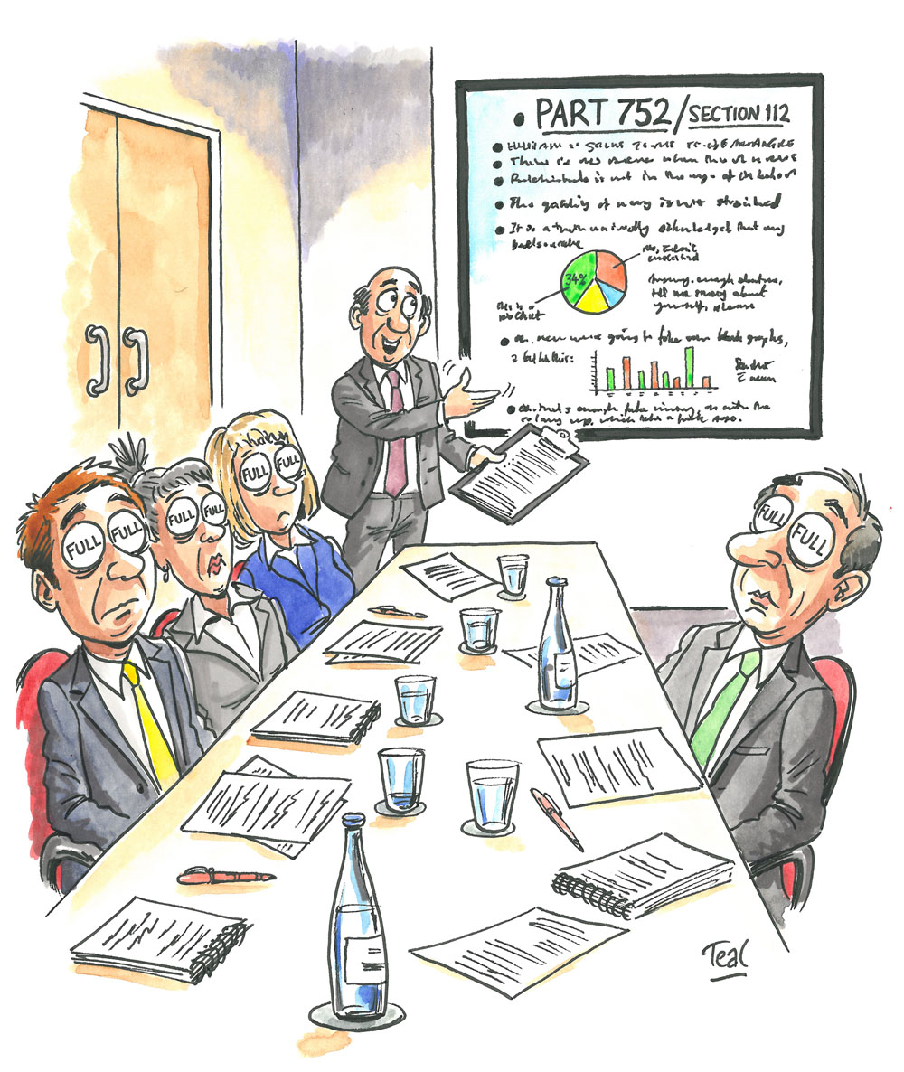
Productive
Notes:
Asking kids what they think being productive in a presentation is….
Productive-->Having deliverables/speaking on a cause/No information overload(don’t fill the slides with text and just read from it, don’t even read from your slide). ----> Having something tangible(not necessarily physical by any means) for the audience to leave with. Having visual aids like powerpoints, videos, brochures.

Slide 7
Present
Notes:
Asking kids what they think being present in a presentation is….
Present--> Not looking down/Only going off your slides/not involving the audience(depending on the type of venue)/ making your presence relatable and attractive. Walking around and hand gestures, tonality and talking slower. Getting people to like you and listen---> Grabbing the audience's attention and keeping it. effectively influencing and charming others The etiquette of presenting basically.

Slide 8
Passion
Notes:
Asking kids what they think being productive in a presentation is….
Passion--> Exuding confidence and honesty in what you are presenting.Being informed and knowledge on the subject.
* Asking and explaining the difference between passion and presence-> Passion is speaking with purpose and excitement(Speaking about your product). Being present is the ability to convince and put forward.
On a more simpler for all intents and purposes (for our non-high school kids) Passion is the wanting to present well, while present is having charisma.
example= computer dude who is really passionate about why we all need to backup our computers. He is passionate cause he is informed on the subject and know all there is to know. However he lacks presence when he talks about it as he sounds boring because he is just reading from a slide, not looking at us and speaking monotone.

Slide 9
Practice
Notes:
Practice--> Writing out your speech(not necessarily word for word) so you know what you are saying/put yourself in situations where you are speaking in front of people/getting feedback→ the point is: if you don’t do it enough how are you going to get better?

Slide 10
Tips to calm the nerves
Make your nervousness enthusiasm
Positive thoughts
Breathe deeply
Smile
Watch a motivational video
(https://www.youtube.com/watch?v=l-gQLqv9f4o)
Notes:
Percent of people who suffer from speech anxiety 74 % (http://www.statisticbrain.com/fear-of-public-speaking-statistics/)
People get nervous when asked to give a public speech
Make your nervousness enthusiasm: convince yourself that the nerves are just the excitement to present
positive thoughts: put yourself in a happy place
breathe deeply: Calms your heart rate, gets oxygen to the brain, and it relaxes you
smile: Smiling increases endorphins, replacing anxiety with calm and making you feel good about your presentation. Smiling also exhibits confidence and enthusiasm to the crowd
motivational video is a kid president video: pep talk

Slide 11
Resources
Improve Your Presentation Skills:http://onforb.es/14H0EbG
Leadership: https://www.ted.com/topics/leadership
Public Speaking: https://www.ted.com/playlists/226/before_public_speaking
Great Public Speakers
Notes:
TED TALKS on leadership and public speaking. Samples of good speakers.

