Slide 1
Graduate School Preparation
Are you ready?

Slide 2
Why go to grad school?
Continue education directly after receiving undergraduate degree
Professionals return to further their education and open new promotion/career opportunities
Specialize in a specific area
Strengthen job security
Part of path to future career (professor, doctor, lawyer)

Slide 3
Education Differences
Graduate Education
Undergraduate Education
Specialized Education
Clear academic & career goals
Fewer classes & shorter overall time commitment
More intense, higher level coursework & expectations
Broader Education
First stepping stone to career
Heavier class load per semester and longer time commitment
Average outcomes are accepted easier

Slide 4
Benefits of Higher-level Education
More specialized education studies and research opportunities
Allows more mastery of skills
Can expand career options
Could create greater marketability
Entry-level to teaching at a university level
Higher salary over career progression
Lower unemployment rates

Slide 5
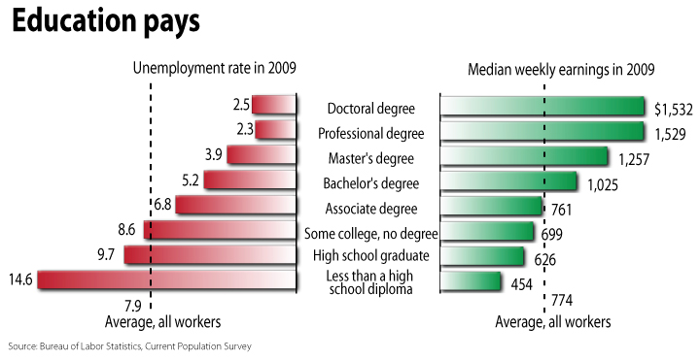
Bureau of Labor Statistics, http://www.bls.gov/emp/emptab7.htm, 5/27/10

Slide 6
Career Considerations
Experience before graduate school
Flow-through or no experience before graduate school
Specialize in career area of interest
More mature perspective on graduate level studies and application
Typically more career options due to having experience
Command higher salaries
Not as clear of areas of interest/specialization
Education not as applicable due to little, if any, professional experience
Potentially lower income & fewer opportunities initially
Educationally qualified but experientially not as qualified
Extremely important to participate in undergraduate and/or graduate level internships before graduating

Slide 7
Documents Needed for Florida Grad Schools
Application-App. fee
Statement of Objective/Intent
Resume/CV
Letters of Recommendation (3)
GRE or GMAT
Official Transcripts
Bachelors Degree - Minimum of a 3.0 GPA
Original undergrad college transcripts

Slide 8
Questions to ask
Can you waive application fee?
What exams are required?
Assistantships or scholarships offered and how to apply?
Prerequisites and how long will it take to complete?
When are the deadlines to apply?

