Slide 1
Emotional Intelligence
Written by:
Ebe Randeree Kelby Mahoney
Presented by:
____________________
Notes:
Pictures of famous presenters.

Slide 2
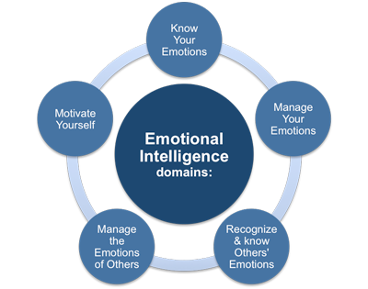
What is Emotional Intelligence (EI)?
https://youtu.be/weuLejJdUu0
Notes:
POI

Slide 3
Four areas
Understanding yourself | Managing yourself
Understanding others | Managing others

Slide 4
Understanding yourself
Understanding yourself When are you most productive? What are your strengths and weaknesses? What do you offer to society? | Managing yourself
Understanding others | Managing others

Slide 5
Managing yourself
Understanding yourself | Managing yourself What are your organizational skills? What do you do with your free time? What are your goals? Short term? Long term?
Understanding others | Managing others

Slide 6
Understanding others
Understanding yourself | Managing yourself
Understanding others How do others around you work? Are you responsive to different personalities? Are you aware of what is going on in the lives of others? | Managing others

Slide 7
Managing others
Understanding yourself | Managing yourself
Understanding others | Managing others Do people respond well to you? Are you a manager or a leader? Do you motivate others to get things done?

Slide 8
How do you understand yourself?
Write down three strengths
Write down three weaknesses
Discuss with those around you to how
to hone in on strengths and overcome
weaknesses

Slide 9
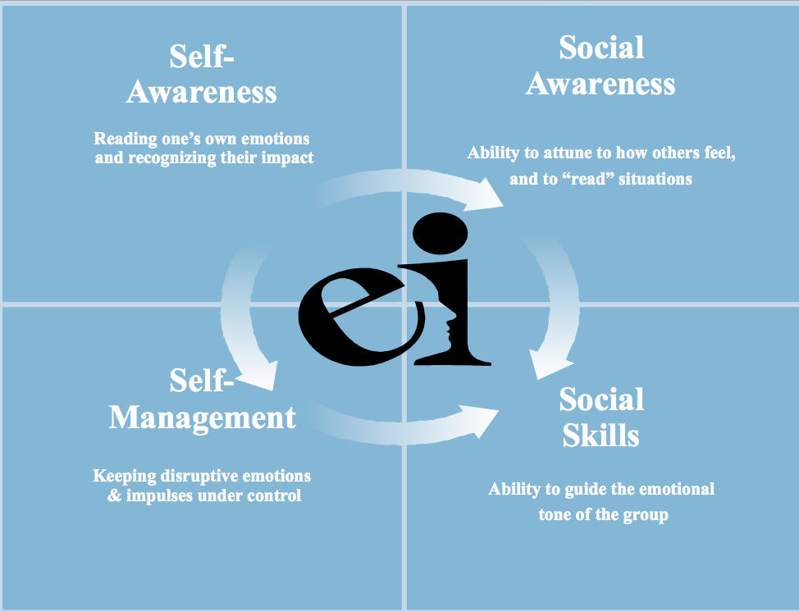
“Throughout the centuries
there were men who took first steps down new roads armed with nothing but
their own visions.”
Ayn Rand

Slide 10
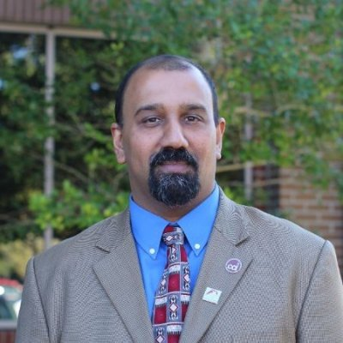
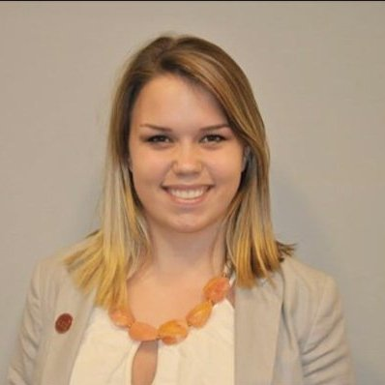
Contact us
https://www.linkedin.com/in/randeree
ebe.randeree@cci.fsu.edu
@eranderee
https://www.linkedin.com/in/kelbymahoney
kelby.mahoney@gmail.com
@KelbyAMahoney

