Slide 1
High School to College
Planning for Transition

Slide 2
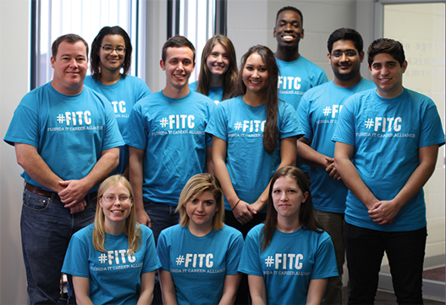
Florida IT Career Alliance
The Florida IT Career Alliance was established to help recruit, retain and employ Florida’s next generation technology workforce

Slide 3
Listen Up!
Personal advice from some of our Ambassadors!
Save your questions till the end!

Slide 4
Lauren Lewis
Major: Management Information Systems & Finance
Minor: Computer Science & Mathematics

Slide 5
Some Advice From Me
Rewind
Questions to ask yourself
Transition from high school to college
Independence
Responsibility
Self-discipline
Have I finished all my college applications?
Did I research financial aid opportunities?
What major do I want to declare?

Slide 6
So, what’s your path?
Do something you love and are passionate about
Be smart in pursuing that dream
Ask questions and seek knowledge

Slide 7
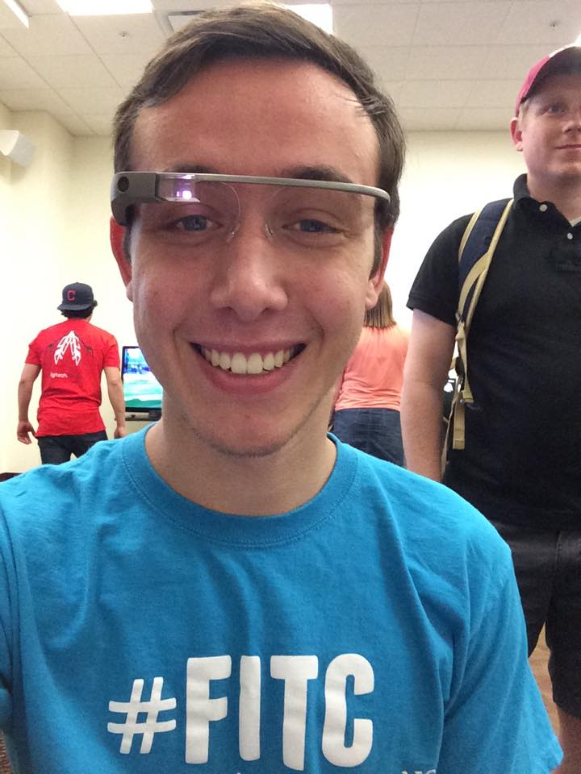
Dominic Fezzie
Major: Computer Science
Focus: To Be Determined
Year: Freshman
Notes:
Why did you choose that major & focus?
I took a programming class in high school and found I really enjoy programming.
I don’t have a focus currently, but I am thinking about specializing in computer security. I believe this is an important aspect as computers become more integrated in our lives. There are more ways a person can steal your personal information, and I want to work to create a safer computer experience.

Slide 8
The Transition
Do as much as you can in High School
AP Classes
Dual Enrollment
Save money!
Do well in your early classes
Boost your GPA!
Get prepared for more difficult classes in future
Get involved
First month of school
Volunteer organizations
Paid jobs! (FITC)
Things to avoid
Failing classes
Legal issues
Notes:
What advice would you give to students transitioning from high school to college?
Do as much as you can in High School: I want to emphasize and stress how valuable AP classes are. Passing them will allow you to get free credits for college and skip prereqs, allowing you to get to your core classes quicker, or take classes that you are interested in. There are also opportunities offered such as dual enrollment or collegiate programs that should be taken advantage of
Get Involved: Getting involved on campus is often looked over. I know I only started getting involved this semester and I regret it. My roommate is involved in many organizations and as a result, has a large number of friends that are useful for networking and getting involved in other things. Also looks good on resume.
Do well in early classes: Self explanatory. Take advantage of easy classes early on to boost GPA
Get Involved: First month of college there are hundreds of organizations recruiting new members. There are associations for finding clubs that would interest you offered by the university. Take advantage of these opportunities and find places to cultivate your interests and meet new friends. There are even paid jobs that can be found such as FITC!
What mistakes have you made in your college experience?
I made the mistake of not getting involved early enough. I did not attend any club meetings and have missed out on opportunities due to this.
What is your goal (where do you see yourself in 5 years) and why did you set that goal?
I see myself graduated from FSU and a masters either from FSU or another school, and entering the job market. I set this goal because I should be graduating in two years time with a bachelors, and it would only take another 2 years for my masters. This would allow me to increase my knowledge and increase my marketability in the job market.

Slide 9
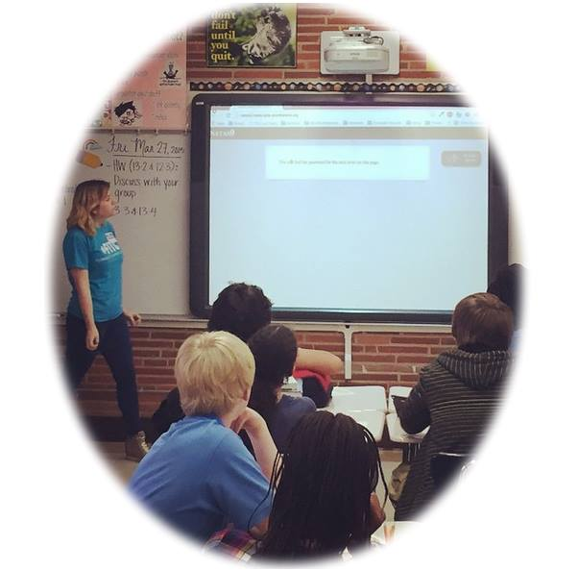
Krystal Salerno
Major: Information Technology
Focus: Database Architecture
and
Information Security

Slide 10
Advice
Social Issues:
How are women really treated?
How many women are in IT?
Are certificates truly important?
It’s more than school
Organizations
Internships/Job
Events
What is expected
Grades
Social Networking
Class work

Slide 11
Rachel Roberson
Major: Chemical Engineering
Focus: Nanotechnology or Polymer

Slide 12
About Me:
Major: Chemical Engineering
Specific area of interest: Nanotechnology or Polymer science
Why?
Love science and math
My dad sparked my interest
Curious about future developments
Relating chemistry and technology
Notes:
When I went to college my first year I loved math and science so I thought my obvious track to follow was medical school. After my first semester I came home for winter break and my dad had this friend that conducts research on nanoparticles for different applications (which basically are very, very small object that behave as their own unit). Thinking nothing of it at the time, he took me to tour their facility and that’s where my interest was actually sparked. That was the day I realized I was curious about science and the innovative applications to technology that are being developed everyday. I went home and changed my major to Chemical Engineering and never looked back.

Slide 13
Advice
Try to find what you love to do as soon as you can, expose yourself to potential areas of study by experiences
Pick a career path and get involved in organizations, jobs, and networks that will help you grow in that area
Look ahead on your academic track
Take time to consider internships, co-ops, and study abroad programs
My mistakes?
Not being prepared initially for the engineering track
Not studying abroad
Notes:
Look ahead at your academic track so there are no surprises for classes you need to take in the future, especially if they are only offered certain terms.
Take some serious consideration into study abroad programs, internships, or co-ops, they are amazing opportunities to gain hands on experiences and help you grow as an individual. Also, make sure that if these are something you want to do to plan for that in your academic track.
My first mistake in college was changing my major to engineering and not considering everything I needed to take to be on track for that path. It took me several semesters to get my prerequisite classes in check and it pushed back my graduation date a semester or two. I also wish that I had studied abroad. It wasn’t something I considered doing until it was too late and I didn’t have any humanities classes left to take, so if I had gone I would have just taken classes for no reason. All of my friends that studied abroad have the most amazing stories and that is one thing I wish I gave myself the experience while in college.

Slide 14
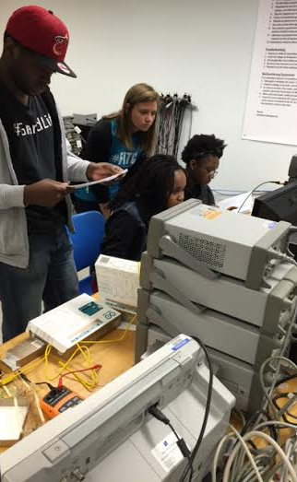
My goals:
Expose myself to as much experience as possible until I graduate
Upon graduating, go straight into industry
In five years: working for a company and continue learning about my field
Earn my Professional Engineer License and work towards advancing my position within a company
Why? Very ambitious and always seek growth and personal development. I want to gain experience for a few years until going back to school for my master’s degree.

Slide 15
Why Technology Fields
Salaries
MIS-Upwards $160K
CS-Upwards $140K
IT-Upwards $120K
CE-Upwards $140K
Benefits
Always In Demand
Tech is in all fields
Global job locations
Notes:
Salaries:
Upward salaries
Medians range around 60-80K
Depends on your field and specialty
Benefits:
There are always tech fields in demand-> people always have an idea. Some one needs to develop the language and communication(cs) someone needs to bring it into the physical world(CE) someone then needs to explain it in lamens terms and support the product for consumers(IT) someone needs to then lead that project(MIS) Technology can be applied in all fields. You just have to figure out what field is for you. Very flexible work enviroment.

Slide 16
Questions?

Slide 17
Follow us on Social Media!
QUESTIONS
/FITCAlliance
@FITCAlliance
@FITC_Alliance
#FITC
& visit fitc.cci.fsu.edu
FITC Group

