Slide 1
Computers Under $100
Joey Cardenas

Slide 2
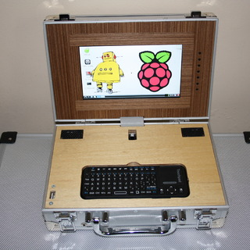
What will you be doing?
DIY Projects
Media Streamer
Security
Education

Slide 3
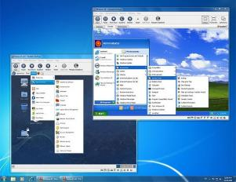
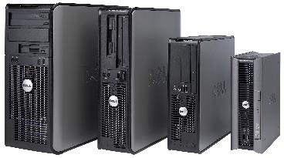
Understand Your Options
DIY Computers
Pre-Owned
Virtual Machine
Notes:
Can you spend a little more
Microprocessors vs older technologies
Still need keyboard, mouse monitor & speakers
Maybe just upgrading your new operating system

Slide 4
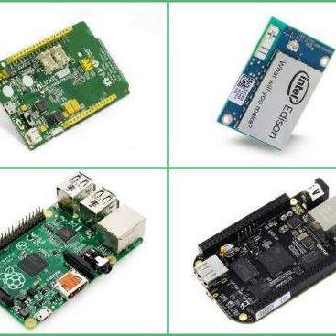
DIY Computers
Notes:
Source:http://www.seeedstudio.com/blog/2014/10/31/linkit-one-vs-edison-vs-raspberry-pi-vs-beaglebone-black/

Slide 5
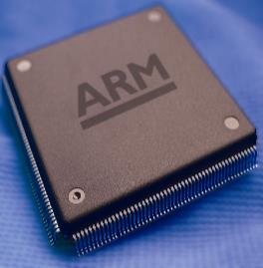
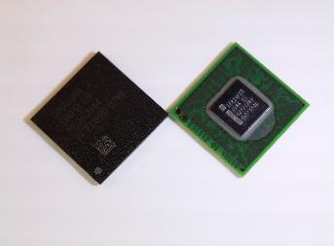
Inside the MicroPc
CPUs
ARM Processors
ATOM Processors
Notes:
ARM Processors:is all about partnership. It owns no fabrication plants and sells no chips under its own banner. Instead, it licenses its CPU core designs to more than 200 semiconductor companies worldwide. Prominent American licensees include Freescale, Marvell, Qualcomm, and Texas Instruments.
Smartphones, tablest, wearables
Atom Processor: Wanted in on the portable device game. good performance at extremely low voltage.
Netbooks, (smartphones), Microsoft Hololense
Source :http://www.v3.co.uk/IMG/431/243431/arm-chip.JPG
http://download.intel.com/pressroom/kits/atom/z6xx/images/IntelAtomProcessorZ6xx_PlatformControllerHub.jpg
http://www.infoworld.com/article/2630144/processors/arm-vs--atom--the-battle-for-the-next-digital-frontier.html

Slide 6
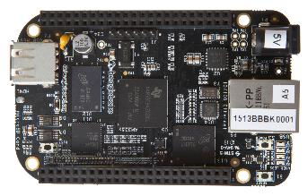
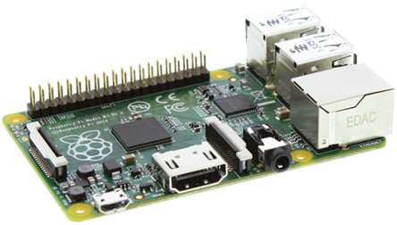
DIY Computers
BeagleBone Black - $49
Most powerful ARM Processor
Best for hardware expandability
Click Boards
Raspberry Pi (b+) - $35
Biggest commercial support
Best for beginners
Notes:
BeagleBone Pros: Lots of pin headers
LED Board, Buzzer, Joystick, GPS, Light Sensor RFID up to 90 different clickboards
Source http://beagleboard.org/boards
http://regmedia.co.uk/2014/07/14/raspberry_pi_b_plus.jpghttp://files.linuxgizmos.com/beaglebone-black-front.jpg
http://upload.wikimedia.org/wikipedia/commons/4/45/Raspberry_Pi_-_Model_A.jpg

Slide 7
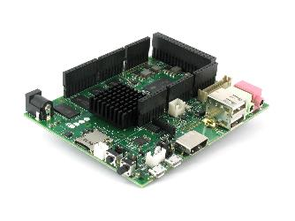
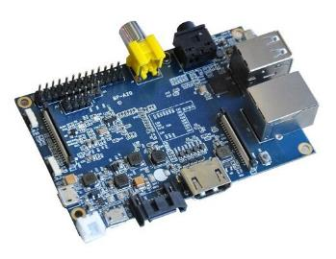
Alternative DIY Computers
UDOO (basic) - $99
Supports Arduino Natively*
More GPIO
Banana Pi (b+) ~ $45
Faster than Raspberry Pi
Hardware improvements
Notes:
Banana Pi: Faster Processor ARM a7 vs ARM a6, 1gig of DDR3 ram compared to 512mb. Runs cooler
UDOO is compatible with all the sketches, tutorials and resources available on the Arduino community as well as all the shields, sensors and actuators for Arduino DUE available on the market.
eSata: Provides faster storage opetions
GPIO-general input out
Source:http://www.pcmag.com/article2/0,2817,2413310,00.asp
\http://liliputing.com/wp-content/uploads/2014/04/banana-pi_05.jpg
http://shop.udoo.org/media/catalog/product/cache/1/image/9df78eab33525d08d6e5fb8d27136e95/1/_/1.jpg

Slide 8
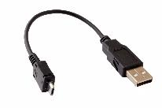
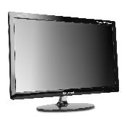
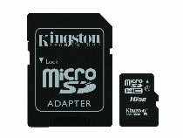
Additional Expenses
Keyboard
Storage (SD Card)
Mouse
Monitor
USB cable
Hardware
Notes:
Keep in mind
Sources:
http://www.quietpc.com/images/products/matias-quiet-pro-keyboards-2-large.jpg
http://www.quietpc.com/images/products/tm-230-led-large.jpg
http://ecx.images-amazon.com/images/I/71f0aXTwI6L._SL1500_.jpg
http://ecx.images-amazon.com/images/I/618X8V0181L._SL1000_.jpg
http://mobymarket.com/ebay/data%20cable/micro%20cable.JPG

Slide 9
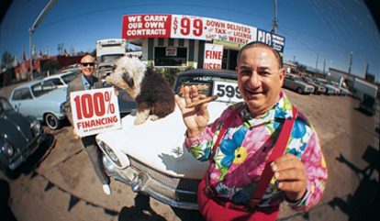
Pre-Owned

Slide 10
Pre-Owned
Generally more powerful hardware
Much cheaper
Experiment more

Slide 11
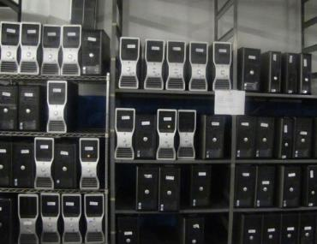
Pre-Owned Resources
Ebay
Craigslist
Goodwill
Surplus Auctions

Slide 12
Tips buying pre-owned
Wipe whatever data is on there
Darricks Boot and Nuke
Buy Bulk
DO NOT LOAD WINDOWS XP
Use a Linux distribution
Ubuntu
Kali
Debian

Slide 13
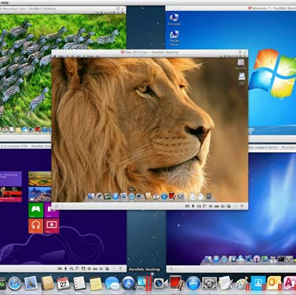
Virtual Machines

Slide 14
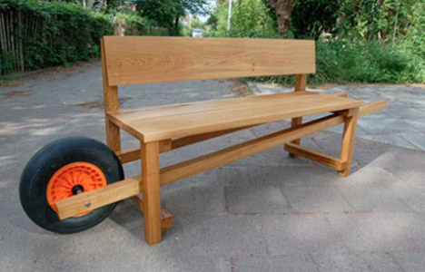
Advantages
Portable
Easiest set up
Practically free
Typically faster (hardware)

Slide 15
What You Need
Virtual Machine
Operating System
Oracle Virtual Box (free)
VMWare Fusion ($70)
Parallels ($80)
Any Linux distribution
Firefox or Chrome OS
Windows
OS X

Slide 16
Summary of Advantages
DIY Computers
Best for tinkers
Education
Most value
Pre-Owned
Powerful
Cheapest
Low opportunity cost
Virtual Machines
Convenient
Simplest
Practical

Slide 17
Follow us on Social Media!
/FITCAlliance
@FITCAlliance
@FITC_Alliance
#FITC
& visit fitc.cci.fsu.edu
FITC Group

