Slide 1
FITC
Andrew Florial
Courtney Lisenbee
Martin Sung
Courtney Patz

Slide 2
What is FITC?
Florida IT Career Alliance
Mission Statement:
To recruit, retain, and employ qualified Florida graduates in competitive computer science, information technology and engineering professions

Slide 3
History
Launched May 2014
$3 million grant supported by the Florida Board of Governors
Florida State University (FSU) and Florida Agricultural & Mechanical University (FAMU)

Slide 4
Our goals:
Align university and college degrees with state’s workforce needs
Spark Interest from K-20 students
Create career pipelines
Uphold higher technology curriculum
Collect and analyze recruitment

Slide 5
Our Student Ambassadors Team:
26 FSU Student Ambassadors
18 FAMU SA
Travel across Florida panhandle
Promoting IT, CS, and Engineering
Provide lectures
Workshop events
Mentoring opportunities

Slide 6
FITC Website: http://fitc.cci.fsu.edu
Upcoming Events
Helpful links
Contact information
Videos
Info Graphics

Slide 7
Social Media
Follow us on Social Media!
/FITCAlliance
@FITCAlliance
fitc.cci.fsu.edu
@FITC_Alliance
FITC Group

Slide 8
FITC Partners

Slide 9
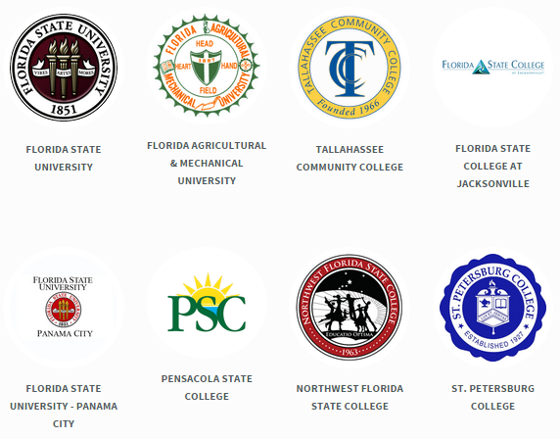
College & University Partners

Slide 10
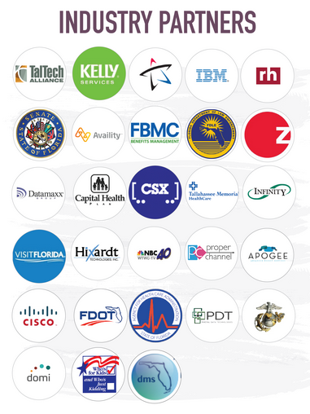
100+ Industry Partners 60+ Florida High Schools
Click for Web Link

Slide 11
CE / CS / IT
The three main fields

Slide 12
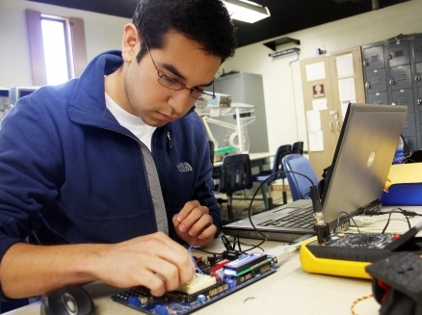
Computer Engineering
Computer engineering is a discipline that integrates several fields of electrical engineering and computer science required to develop computer hardware and software.

Slide 13
Computer Science
Computer Science is the study of computers and computational systems. Unlike electrical and computer engineers, computer scientists deal mostly with software and software systems; this includes their theory, design, development, and application.

Slide 14
Information Technology
IT professionals possess the right combination of knowledge and practical, hands-on expertise to take care of both an organization’s information technology infrastructure and the people who use it.

Slide 15
Follow us on Social Media!
/FITCAlliance
@FITCAlliance
@FITC_Alliance
#FITC
& visit fitc.cci.fsu.edu
FITC Group

