Slide 1
Making your own path
By: Lauren Lewis

Slide 2
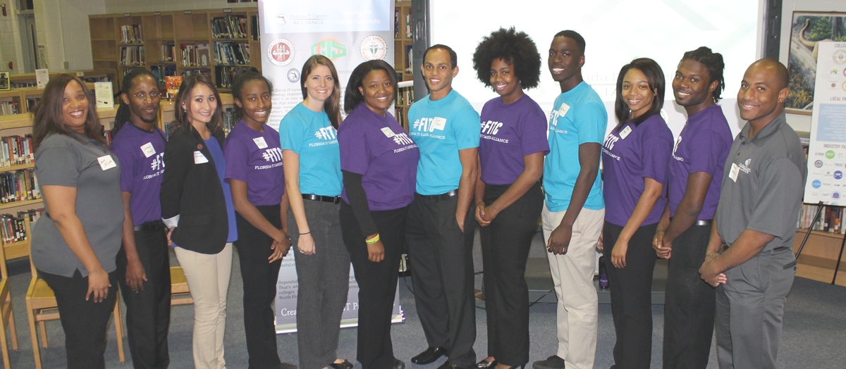
What is the Fitc alliance?
The Florida IT Career Alliance was established to help recruit, retain and employ Florida’s next generation technology workforce
Notes:
Talk about student ambassadors role, majors we focus on

Slide 3
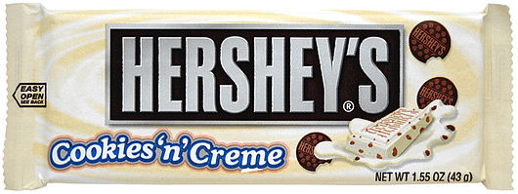
A little bit about me
Name: Lauren Lewis
School: Florida State University
Year: Senior
Major: Management Information Systems & Finance
Minor: Computer Science & Mathematics

Slide 4
Rewind
Transition from high school to college
Independence
Responsibility
Self-discipline
Questions to ask yourself
Have I finished all my college applications?
Did I research financial aid opportunities?
What major do I want to declare?
Notes:
Talk about personal transition

Slide 5
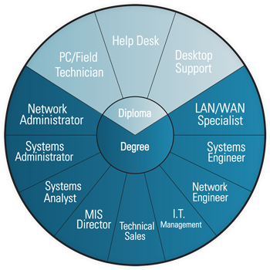
Why study technology?
The Importance of Coding:
http://youtu.be/MwLXrN0Yguk

Slide 6
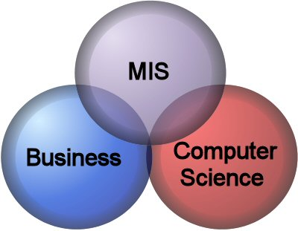
Management information systems
What is it?
Focuses on developing technical and managerial competency and specifically deals with effectively utilizing information for operations and organizational decision making
In other words, professionals in the MIS field serve as the bridge between business and technology in an organization
Core coursework
Management Information Systems Analysis and Design
Information for Operating Control and Data Management
Information and Communications Systems Management
Fun Facts!
Total hours required: 120
Only requires one programming class
Tony DiBenedetto, CEO of Tribridge, graduated from FSU with an MIS degree in 1987
Notes:
Also mention business coursework and electives

Slide 7
Systems analysis & design project
Business Scenario
An owner of a pool service company is looking to expand his business. He currently does not use a computer system to manage his operations. The owner is looking for help to implement a system for this business.
Brainstorm
What could the owner of a pool service company use a computer system for?
Inventory
Customers
Services
Employees
Notes:
Exit from PowerPoint to show project in Access

Slide 8
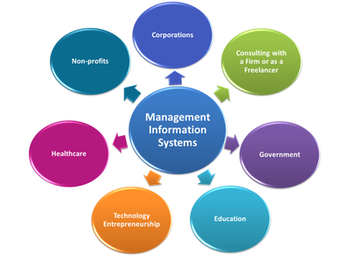
Careers in mis
My path…
June – August 2014:
Interned with KPMG
September 2014:
Accepted full time
offer with KPMG in
CIO advisory division
May 2015:
Graduate
TBD:
Start being an adult?

Slide 9
So, what’s your path?
Do something you love and are passionate about
Be smart in pursuing that dream
Ask questions and seek knowledge
The Internet of Things:
http://nyti.ms/1yt5a83

Slide 10
Questions?
Follow FITC
/FITCAlliance
@FITCAlliance
@FITC_Alliance
FITC Group

