Slide 1
Coding Resources
April Byrne
Gabriella Fraenk
Rachel Bryson
Deja Lindsey

Slide 2
Introduction
Names
Majors
Year in School

Slide 3
Overview
What is code?
What is coding used for?
Resources to begin your coding adventures!
Exercises
Q&A

Slide 4
What is Code?
[video]

Slide 5
Coding Demystified
A set of instructions that tells a computer what to do
Developers used code to write a software language or program (website or app)
Using different languages to give instructions to a computer or device to perform a task
Takes teamwork with proper communication
….it’s EVERYWHERE!

Slide 6
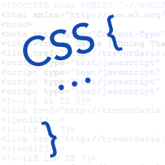
Resources
Code.Org
Codecombat.com
W3schools.com
Codeacademy.com
Stackoverflow.com

Slide 7
Follow us on Social Media!
/FITCAlliance
@FITCAlliance
@FITC_Alliance
#FITC
& visit fitc.cci.fsu.edu
FITC Group

