Slide 1
Careers in Information Technology
Milton Ramer &
Courtney Lisenbee

Slide 2
Who Are We?
Name, majors, career goals, etc.

Slide 3
What is FITC?

Slide 4
FITC and Technology
Information Technology
Information Communication Technology (ICT)
Computer Science
Computer Engineering

Slide 5
What is Information Technology?
The study or use of systems (especially computers and telecommunications) for storing, retrieving, and sending information.

Slide 6
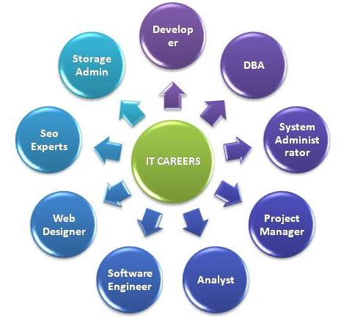
Careers in Information Technology
Web Development/Design
Game Development/Design
Systems Analyst
Network Administrator
Database Administrator

Slide 7
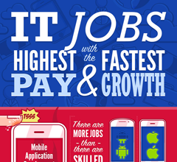
Careers in Information Technology
Information Security
Network Security
Mobile App Development
Software Developer
IT Project Manager

Slide 8
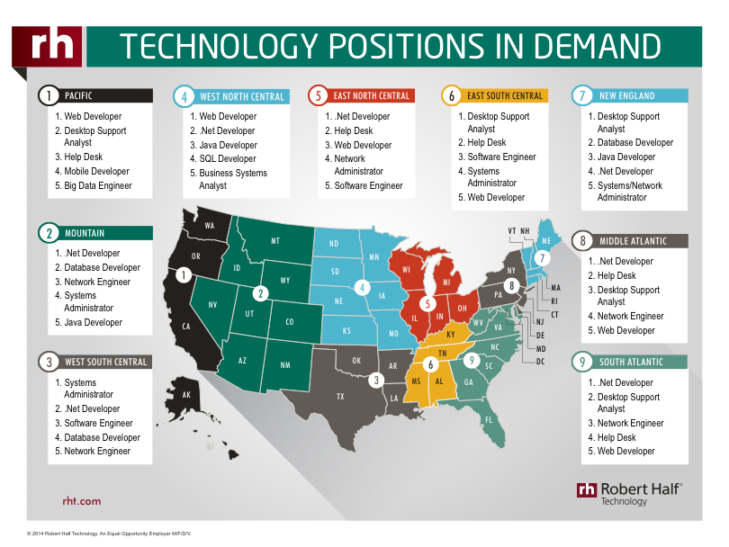
Careers in Information Technology

Slide 9
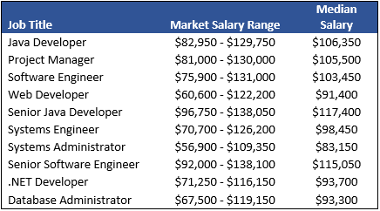
Salaries in IT
IT Jobs
IT Jobs

Slide 10
Follow us on Social Media!
/FITCAlliance
@FITCAlliance
@FITC_Alliance
#FITC
& visit fitc.cci.fsu.edu
FITC Group

