Slide 1
Careers in Computer Science & Computer Engineering
Dominic Fezzie

Slide 2
What is Computer Science & Computer Engineering?
Computer Science:
“The study of computers and their uses” (Merriam Webster)
Computer Engineering:
“A discipline that integrates several fields of electrical engineering and computer science required to develop computer hardware and software” (Merriam Webster)

Slide 3
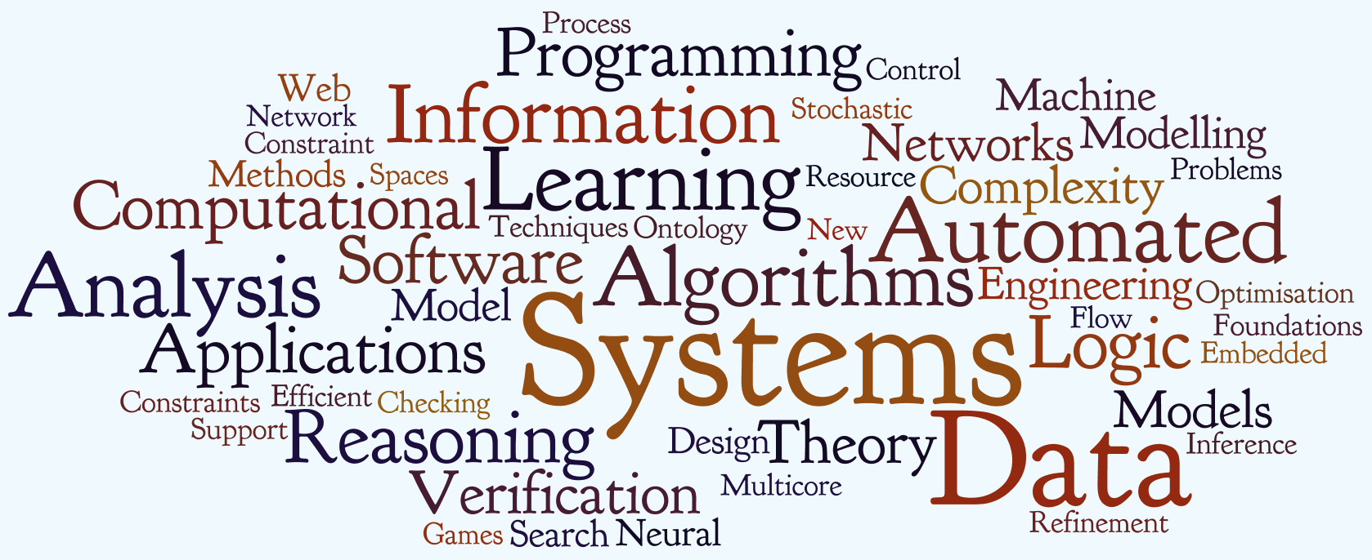
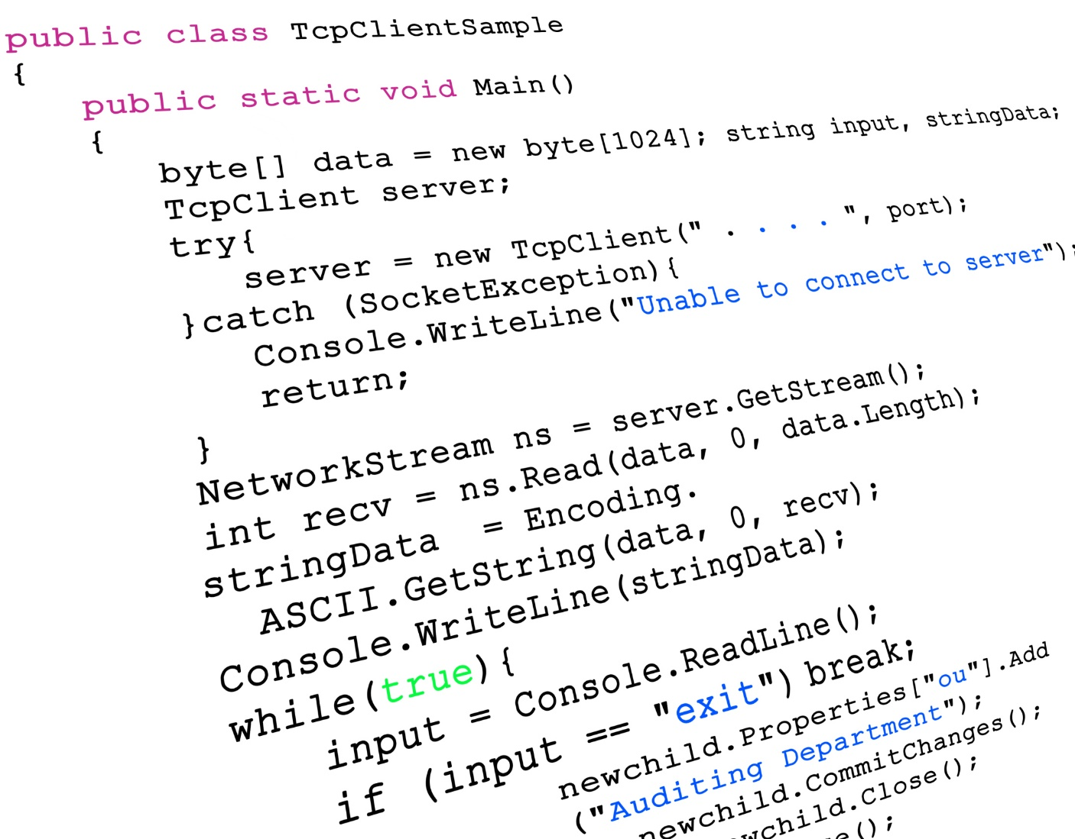
Computer Science in Actuality

Slide 4
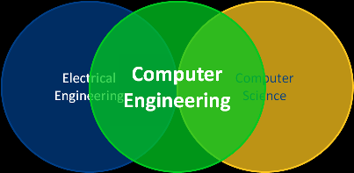
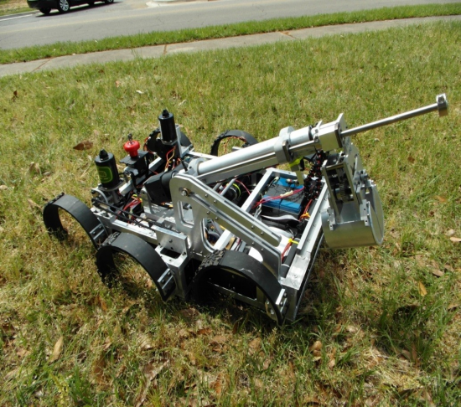
Computer Engineering in Actuality

Slide 5
Computer Science Jobs
Software Architecture and Development
Mobile Application Development
Healthcare IT
Video Game Design

Slide 6
Computer Engineering Jobs
Systems Analyst
Mechanical Design Engineer
Electrical Controls Engineer
Network Engineer/Systems Administrator

Slide 7
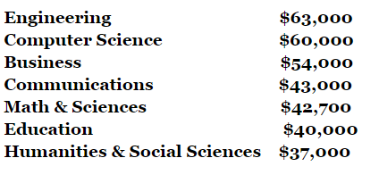
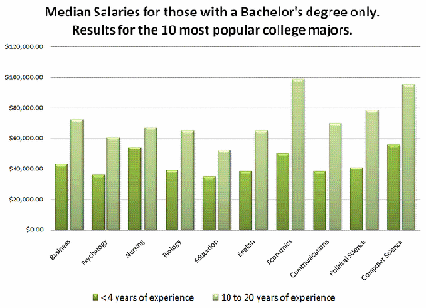
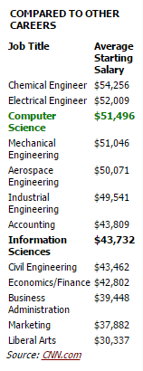
Salaries

Slide 8
Why Major in CS or Computer Engineering?
Competitive Salaries
Job Opportunities
Ever increasing prevalence of technology
Necessary components in any profession

Slide 9
Follow us on Social Media!
/FITCAlliance
@FITCAlliance
@FITC_Alliance
#FITC
& visit fitc.cci.fsu.edu
FITC Group

